Slide 1
While loop constraints in Python
Manjunath R Hegde(PES2201800110)
Tejus D (PES2201800148)
Mukthi Prada.G.M (PES2201800310)
Compiler Design Mini Project

Slide 2
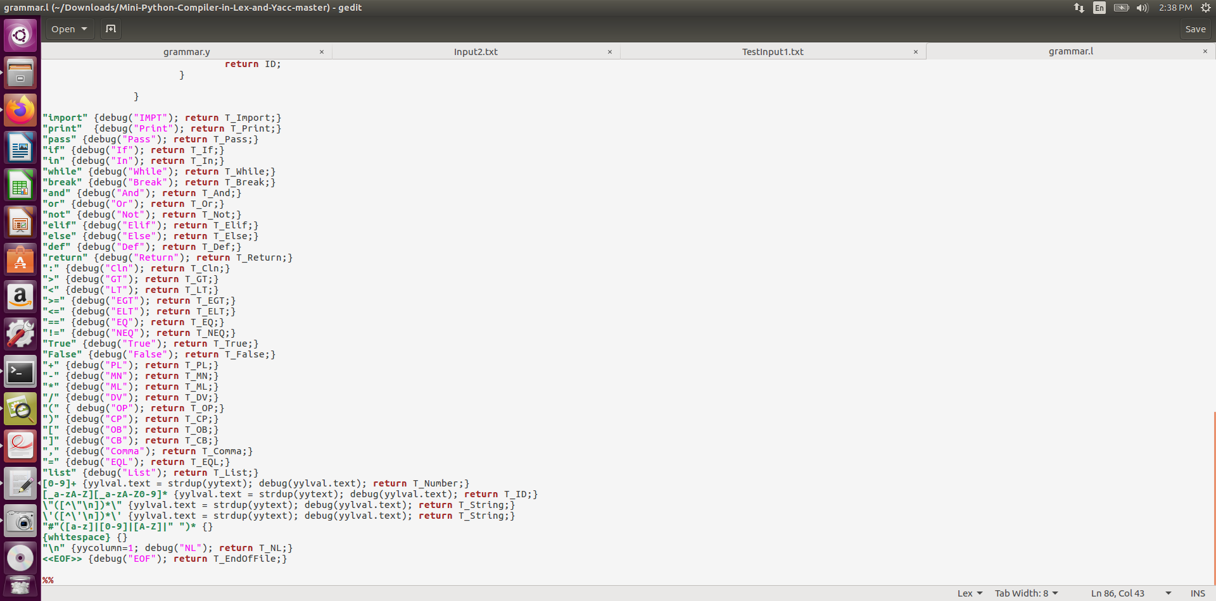
Lexical Analysis

Slide 3
Symbol Table
The Symbol Table stores ‘Records’ having 4 columns as you can see in the sample
output, ie,
❖ Scope : Scope of each variable contained in record
❖ Name : Value/Name of each variable contained in record
❖ Type : Type of each variable contained in record
➢ PackageName
➢ Func_Name
➢ Identifier
➢ Constant
❖ Declaration : Line of Declaration of each variable contained in record
❖ Last Use Line
The scope is a function of Indentation depth and to make it unique we have a tuple
of the scope of the parent and the current scope calculated using the Indentation

Slide 4
Implementation Of Indent Scope
To take care of the Indentation based code structure and scoping we have implemented a stack and we use 3 tokens. The top of the stack always points to the current indentation value, if that value on scanning the next line, doesn’t change, it implies that we’re in the same scope and hence, we return the token ‘ND’, i.e, ‘No-dent’. If the value increases, it means we are entering a sub-scope and we return the token ‘ID’ , i.e. ‘Indent’ and finally, if the value decreases, it means we’re returning to one of the enclosing scope and we return ‘DD’, i.e. ‘Dedent’.
For Error Handling, Whenever the parser encounters an error,It prints syntax error
Augmenting the grammar: A method of anticipating common errors that might be encountered in the input. Such parser will detect anticipated errors whenever error production is used.

Slide 5
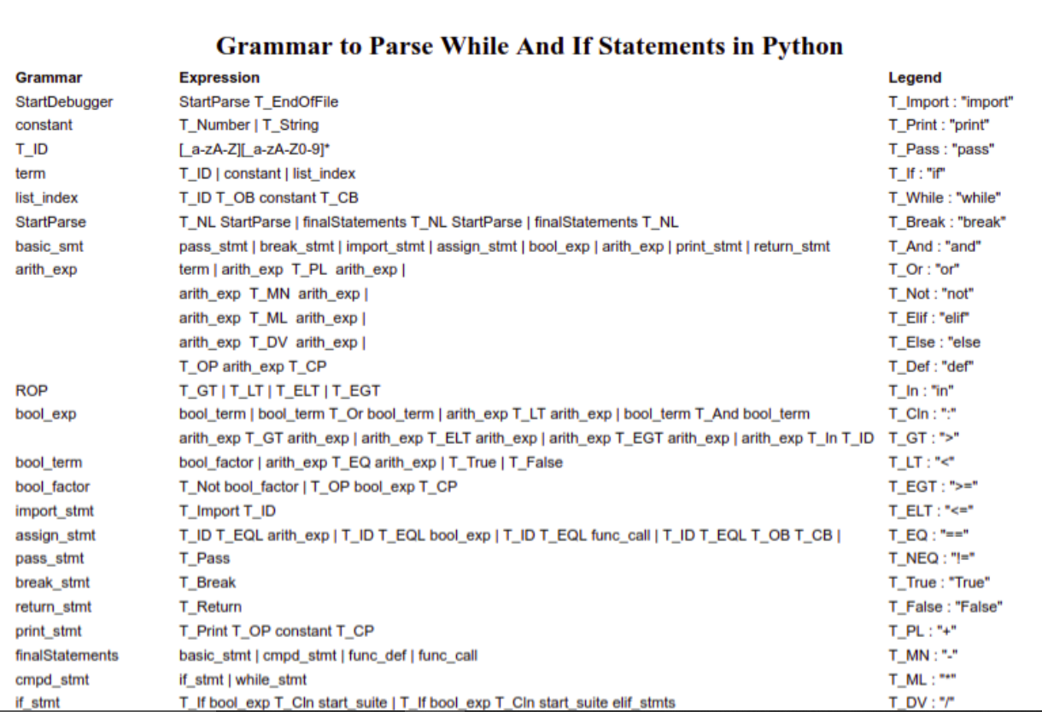

Slide 6
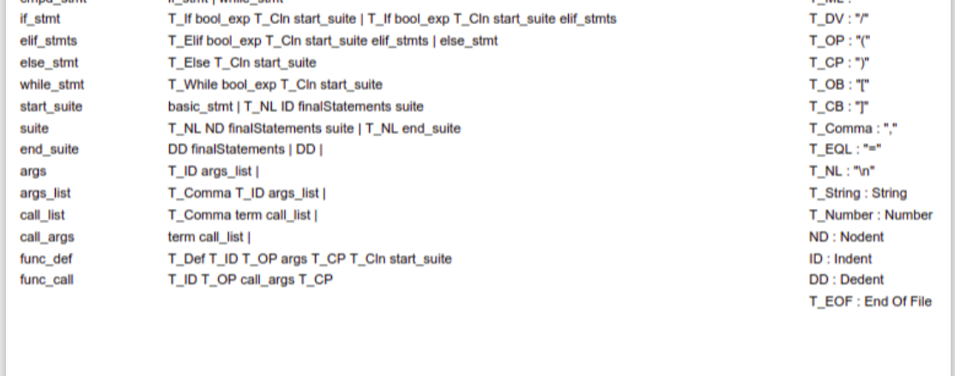

Slide 7
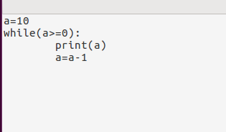
Input1

Slide 8
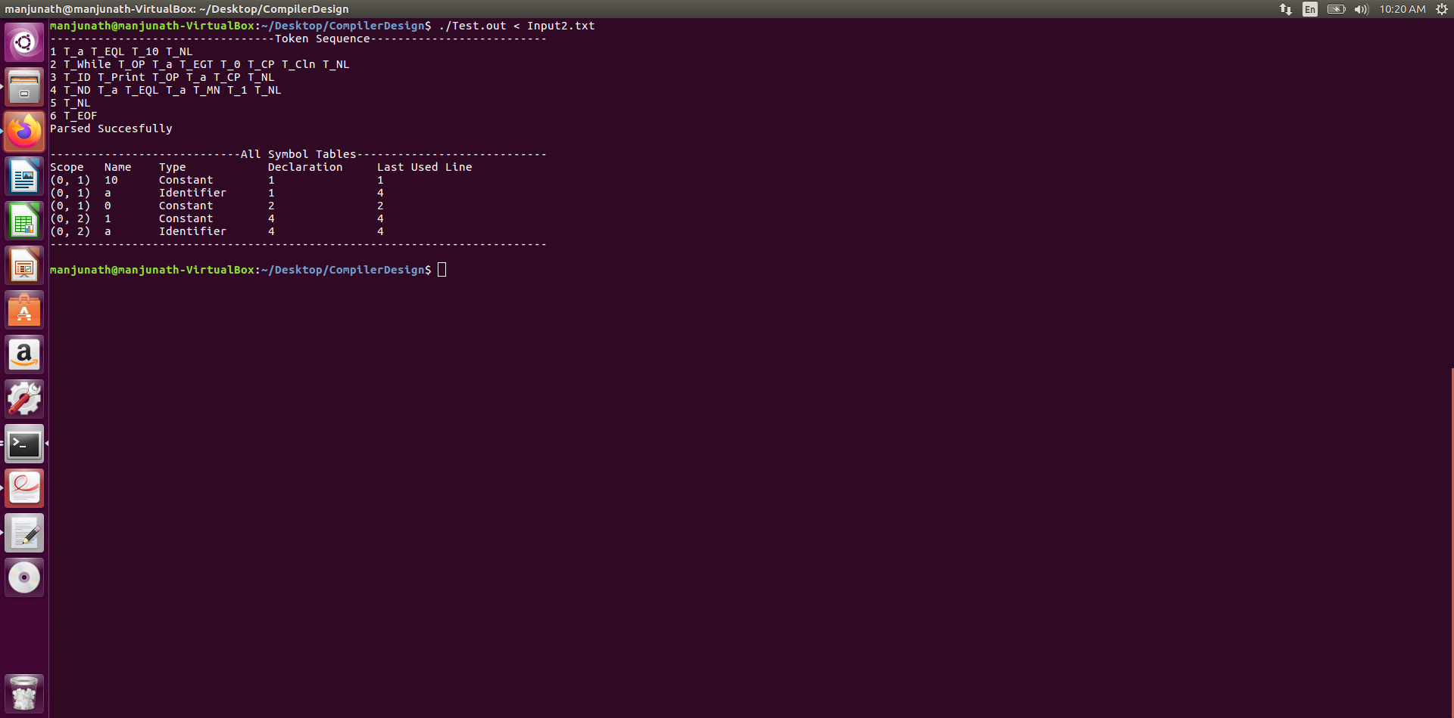
OutPut:

Slide 9
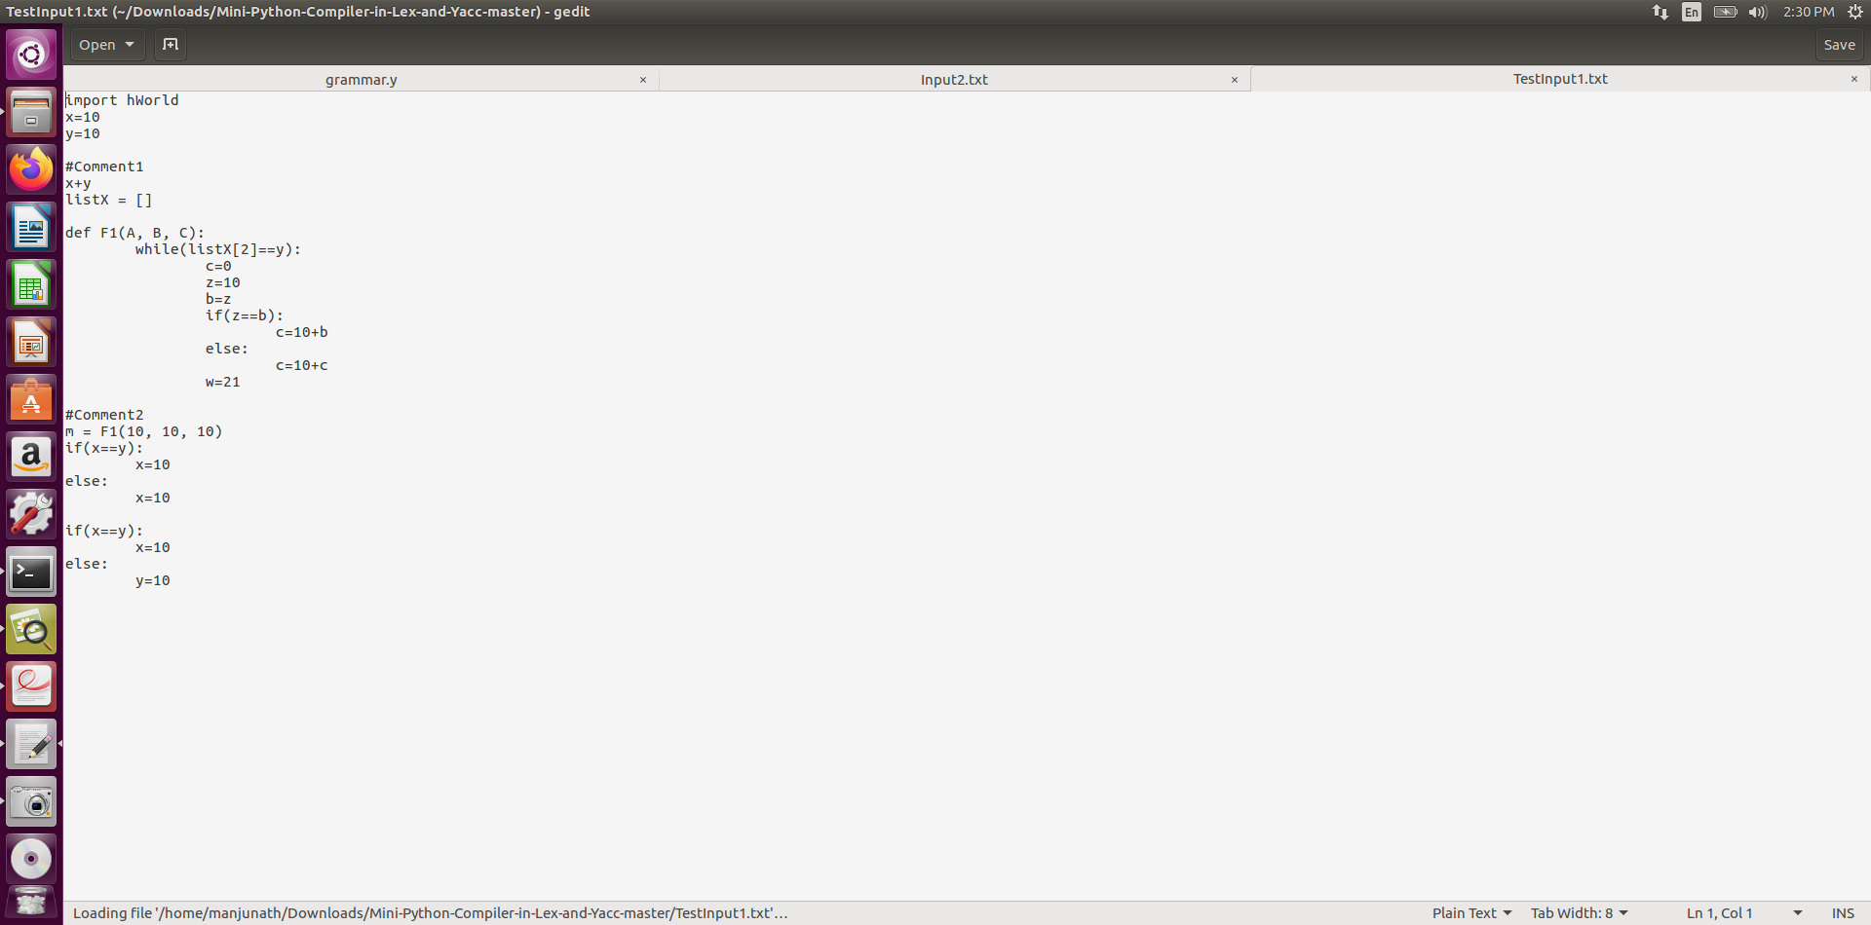
Input2

Slide 10
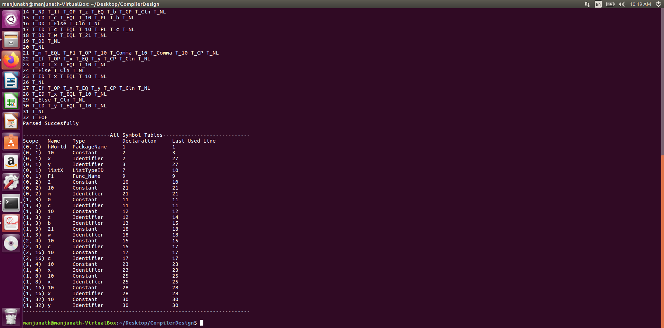
Symbol Table

Slide 11
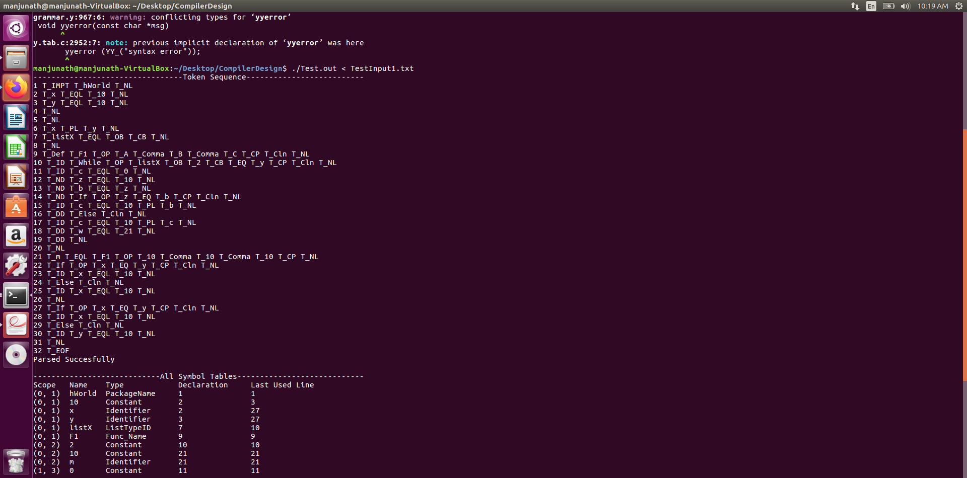
Token
Sequence

Slide 12
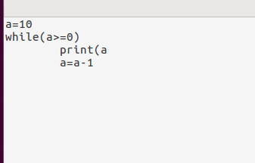
Error Input

Slide 13
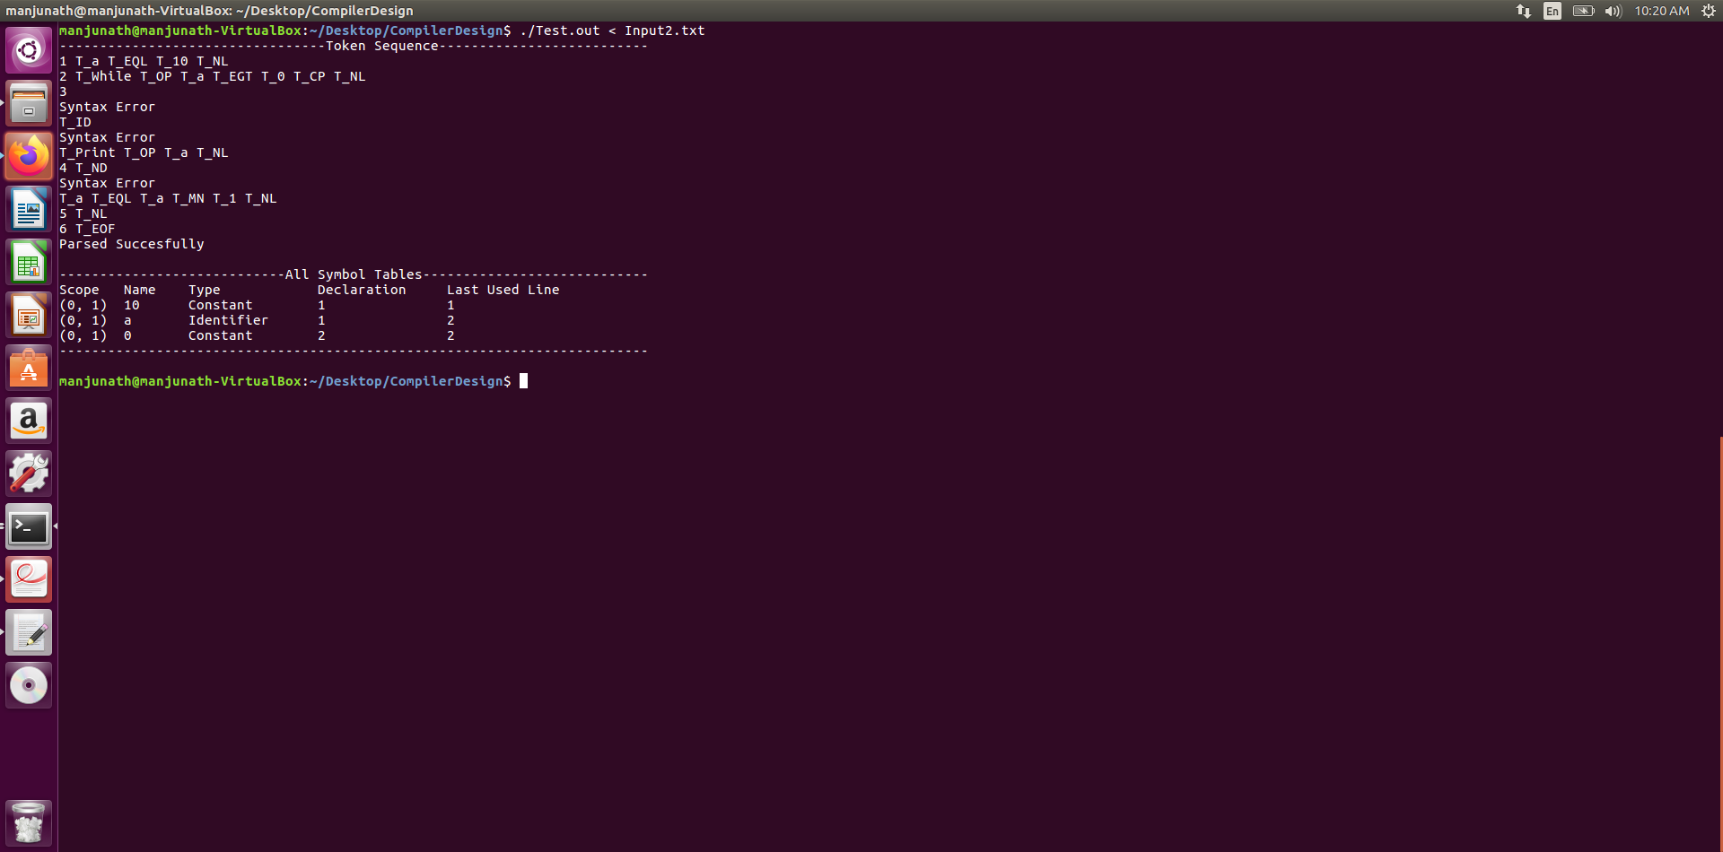
Error

Slide 14
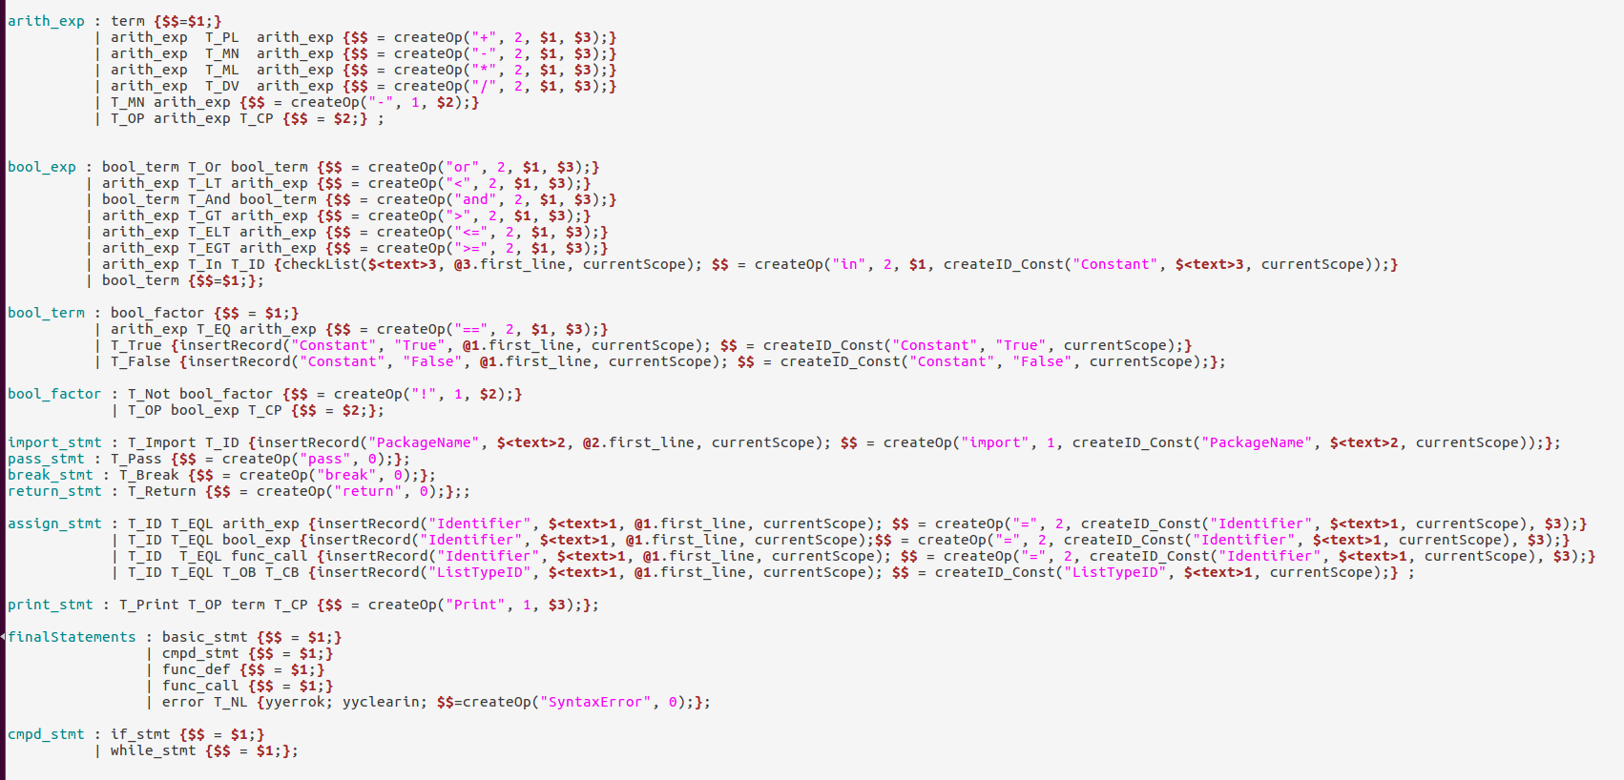
Augmenting (Panic Mode Recovering
)

Slide 15
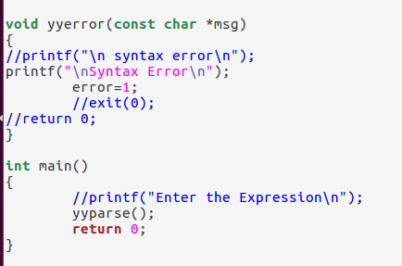
When ever Error is encountered yyerror() method is called

